Slide 1


Transport Layer Protocols
Associate Professor
Department of Computer Science and Engineering

Slide 2
Topics of Discussion
In this session we will learn the following
UDP protocol
TCP protocol
SCTP protocol

Slide 3
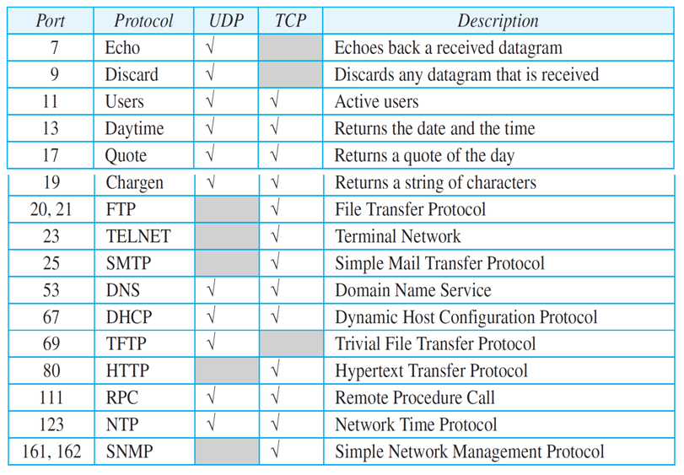
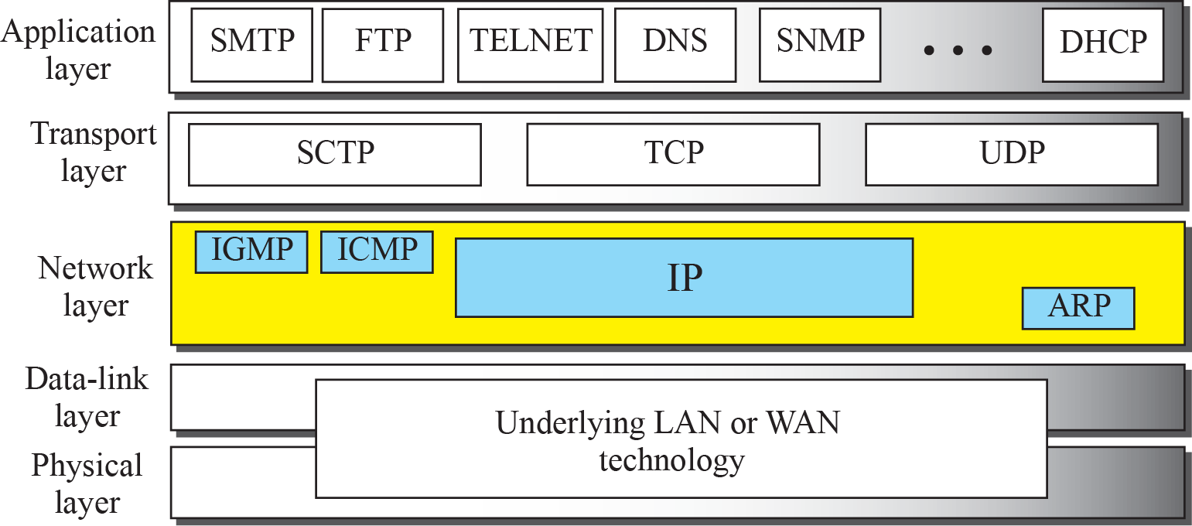
Transport Layer Protocols
A transport-layer protocol usually has several responsibilities.
One is to create a process-to-process communication; these protocols use port numbers to accomplish this.
Port numbers provide end-to-end addresses at the transport layer and allow multiplexing and demultiplexing at this layer, just as IP addresses do at the network layer.

Slide 4
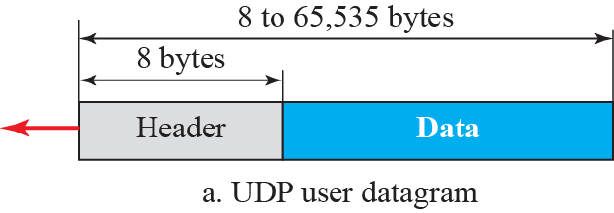
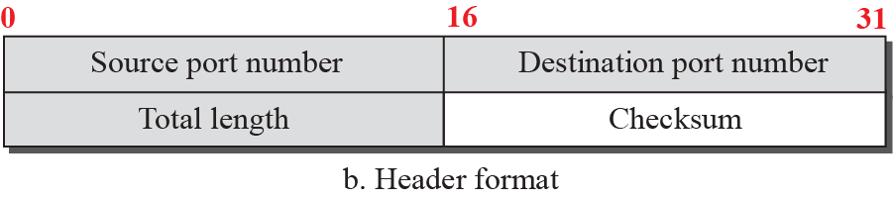
UDP protocol
The User Datagram Protocol (UDP) is a connectionless, unreliable transport protocol.
UDP is a very simple protocol using a minimum of overhead.
UDP packets, called user datagrams, have a fixed-size header of 8 bytes made of four fields, each of 2 bytes (16 bits).
The first two fields define the source and destination port numbers.
The third field defines the total length of the user datagram, header plus data.
The 16 bits can define a total length of 0 to 65,535 bytes.
However, the total length needs to be less because a UDP user datagram is stored in an IP datagram with the total length of 65,535 bytes.
The last field can carry the optional checksum (explained later).

Slide 5
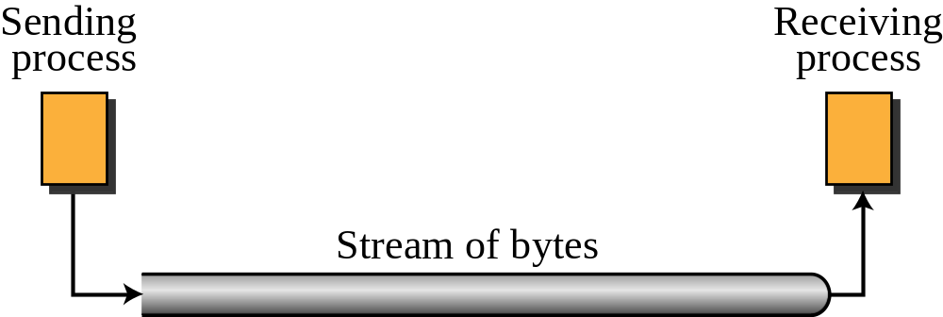
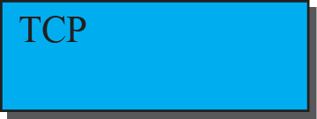
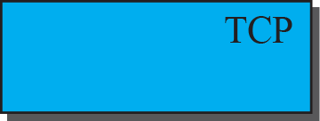
TCP Protocol
Transmission Control Protocol (TCP) is a connection-oriented, reliable protocol.
TCP explicitly defines connection establishment, data transfer, and connection teardown phases to provide a connection-oriented service.
TCP uses a combination of GBN(Go-Back-N) and SR(Selective Repeat) protocols to provide reliability.

Slide 6
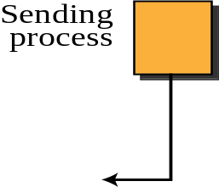
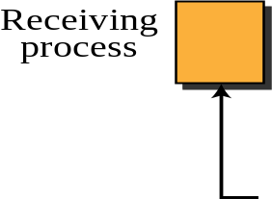
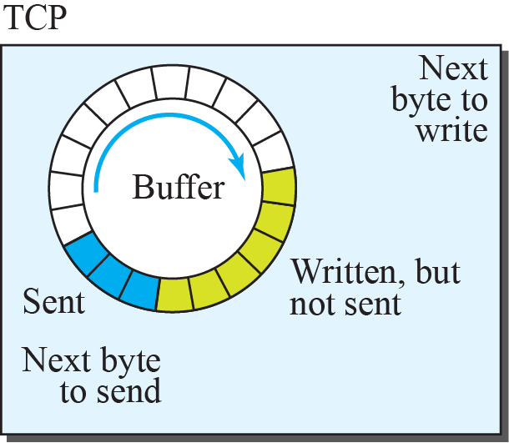
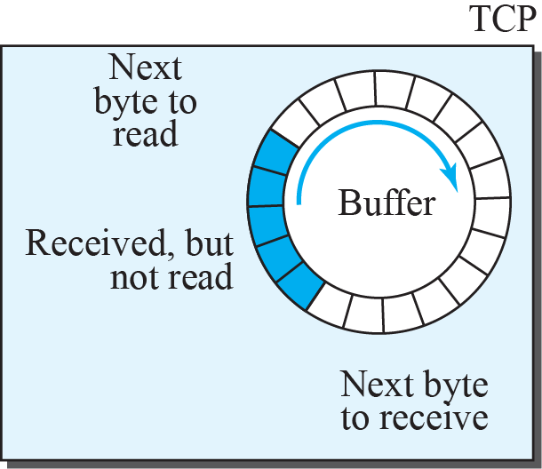
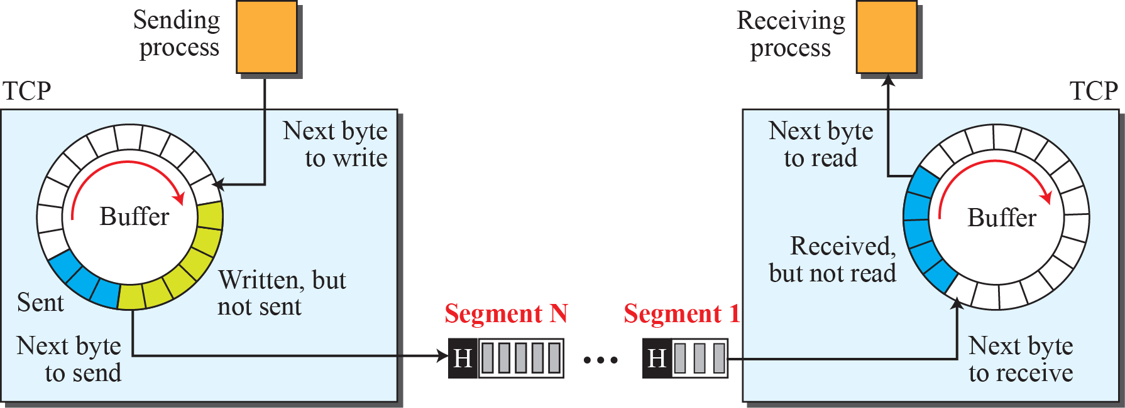
Sending and Receiving Buffers
TCP Segment

Slide 7
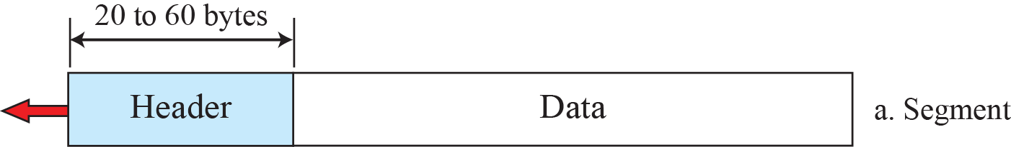
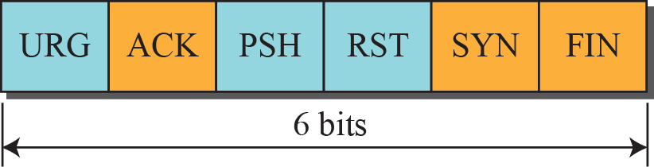
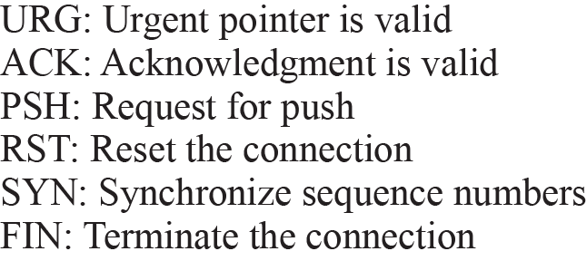
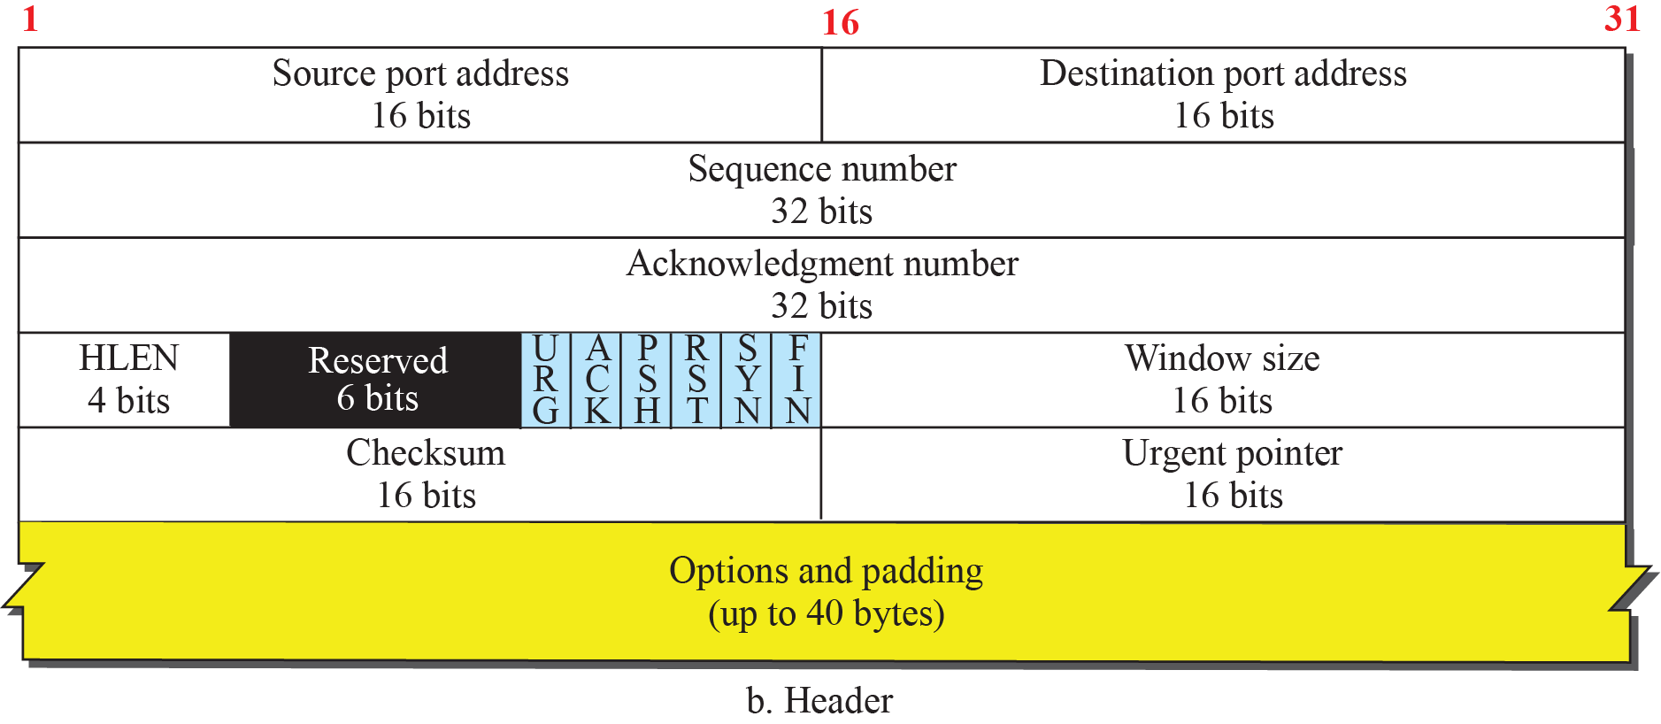
TCP Segment Format

Slide 8
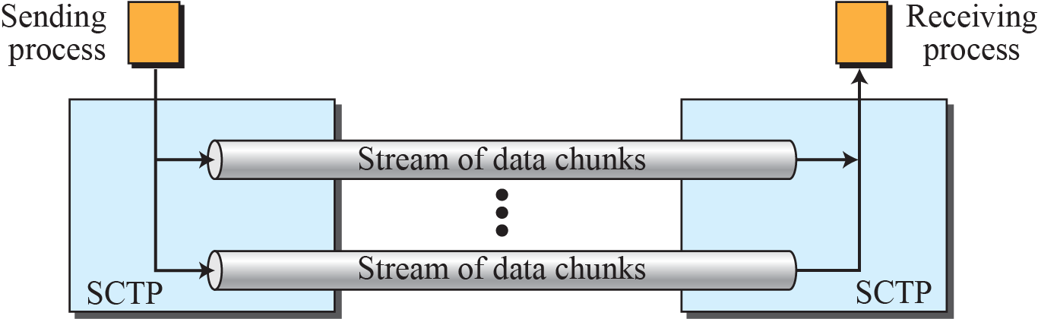
SCTP Protocol
Stream Control Transmission Protocol (SCTP) is a new transport-layer protocol designed to combine some features of UDP and TCP in an effort to create a protocol for multimedia communication.
Multiple-stream concept

Slide 9
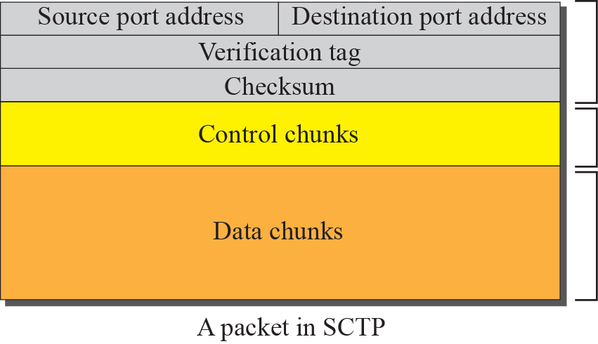
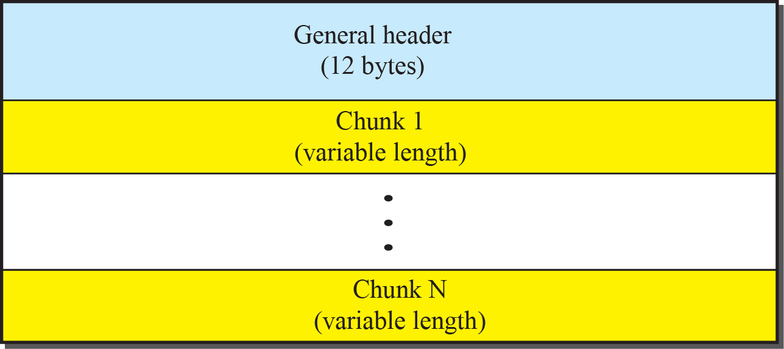
SCTP Frame format and Chunks
An SCTP packet has a mandatory general header and a set of blocks called chunks.
There are two types of chunks: control chunks and data chunks.
A control chunk controls and maintains the association; a data chunk carries user data.
In a packet, the control chunks come before the data chunks.
Figure above shows the general format of an SCTP packet.

Slide 10
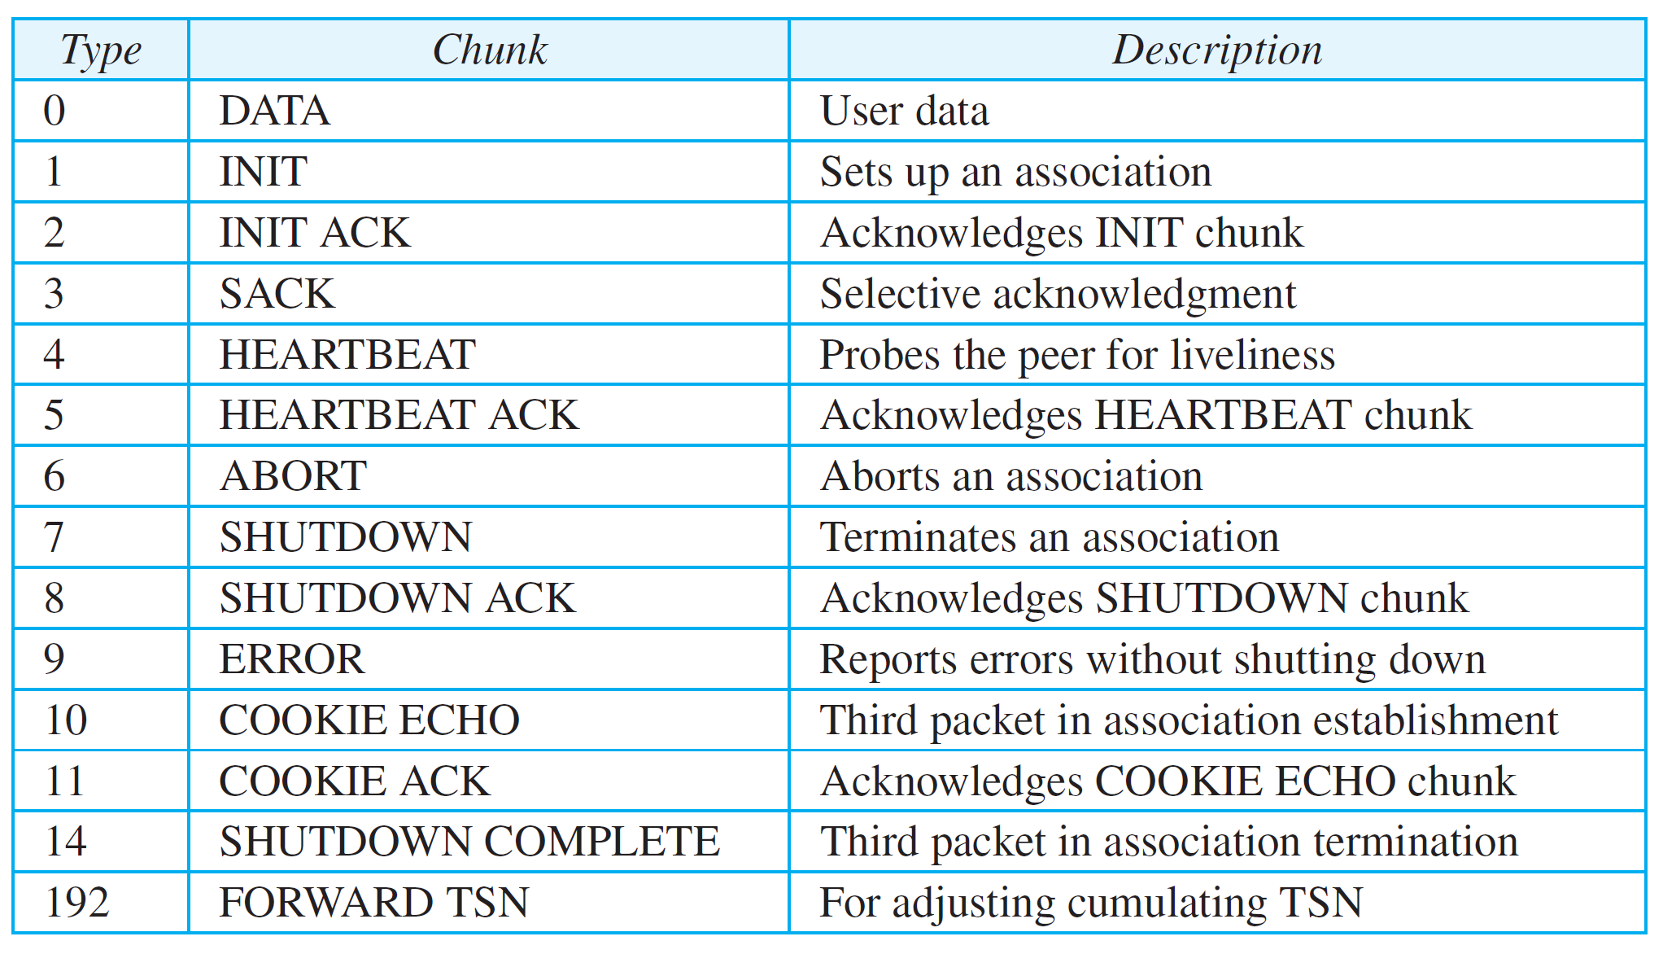
Chunks

Slide 11
Summary
In this section we have discussed the following:
TCP, UDP and SCTP working and frame formats
Notes:
1.#

Slide 12

Notes:
1.#

